Slide 1
Agenda:
Guest speaker: Yoav
Sr. Director of e-Commerce, Bed Bath and Beyond
Course evaluation
Notes:
Real world perspective from my former boss. Yoav. now Sr. Director BBB.
Mizzou project
Learn mkt research basics. And apply. And learn the statics and why and how for manager.

Slide 2
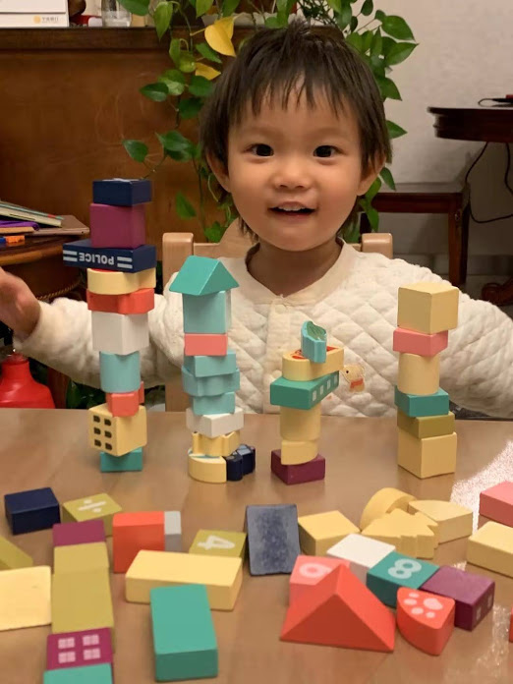

Slide 3
Go to the evaluation link below and choose Students evaluation:
https://evaluation.missouri.edu/
Class: MRKTNG 4050 Section 02
(Marketing Research)
Course number: 56593
Instructor: Yufan Lin
Notes:
Real world perspective from my former boss. Yoav. now Sr. Director BBB.
Mizzou project
Learn mkt research basics. And apply. And learn the statics and why and how for manager.

